Slide 1

Exploratory Data analysis and building a Neural network model
Anshu Anamika

Slide 2
Pima Indians diabetic data set
The Pima Indians (also called the Akimel O’odham) are a group of Native American people who traditionally lived in what is now central and southern Arizona.
The Pima Indian community in Arizona has one of the highest rates of Type 2 diabetes in the world.
Collected by :U.S. National Institute of Diabetes and Digestive and Kidney Diseases (NIDDK) to study the factors contributing to diabetes in this specific population,
The Pima Indians Diabetes Dataset was recorded during the late 1960s to early 1990s

Slide 3
Exploratory data analysis
768 Rows & 9 Columns: 'Pregnancies', 'Glucose', 'BloodPressure', 'SkinThickness', 'Insulin', 'BMI', 'DiabetesPedigreeFunction', 'Age', 'Outcome’
No missing values but 5 columns 'BloodPressure','Insulin', 'BMI', 'SkinThickness','Glucose’ have zero values which indicates missing values
Replace the zeroes with Nan

Slide 4
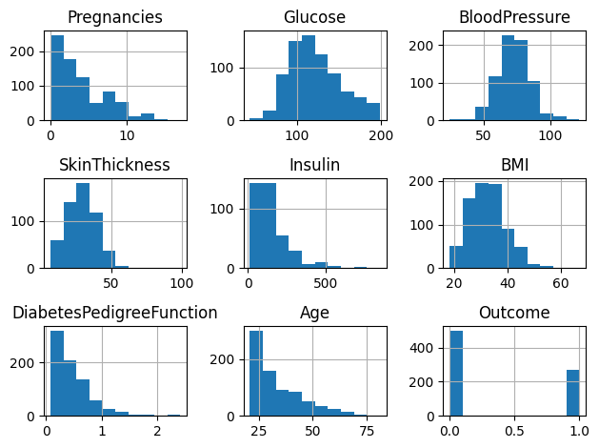
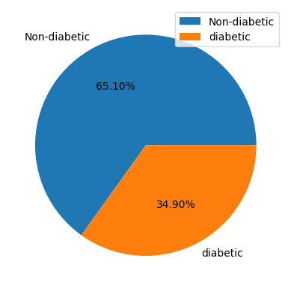
Data distribution

Slide 5
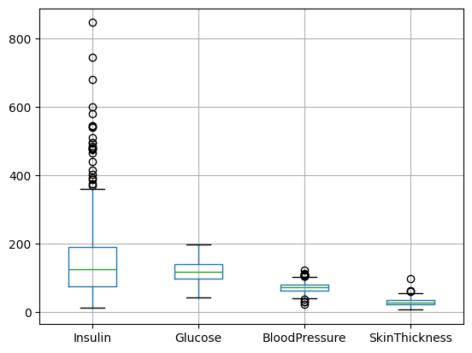
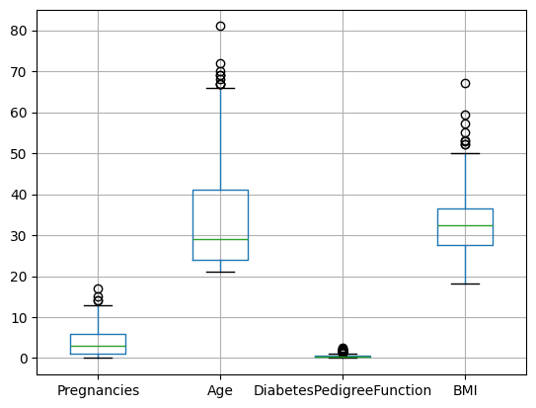
Any outliers?

Slide 6
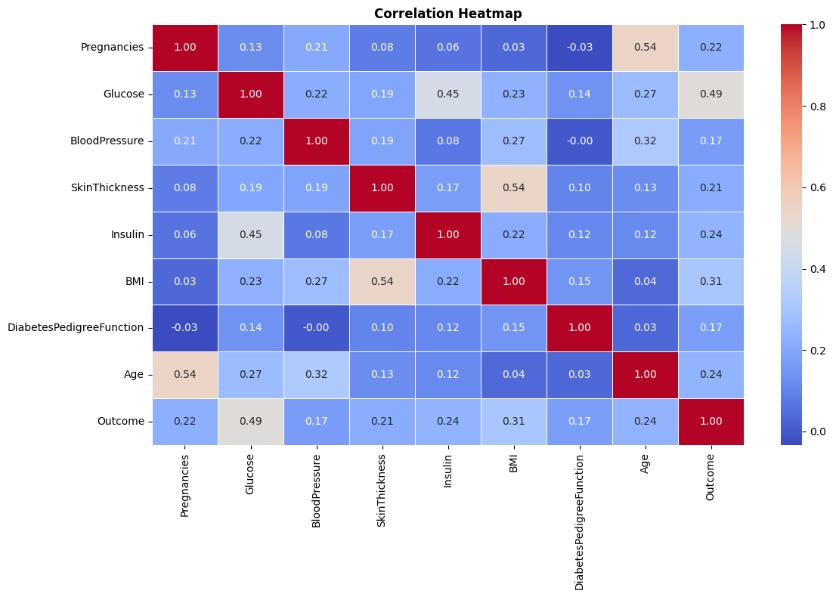

Slide 7
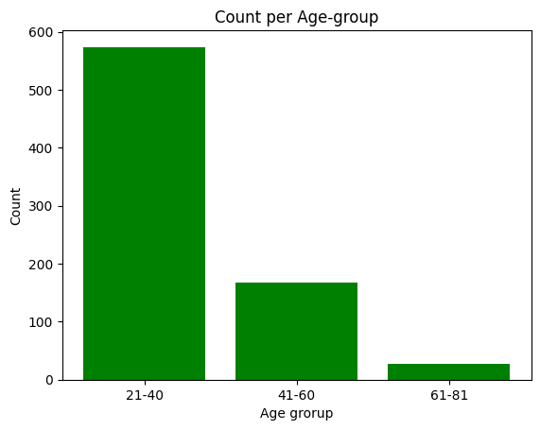
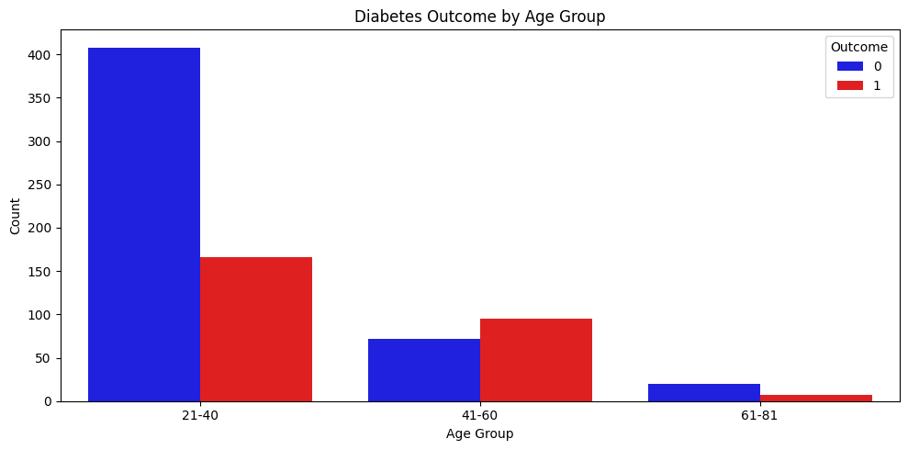
Diabetes by age

Slide 8
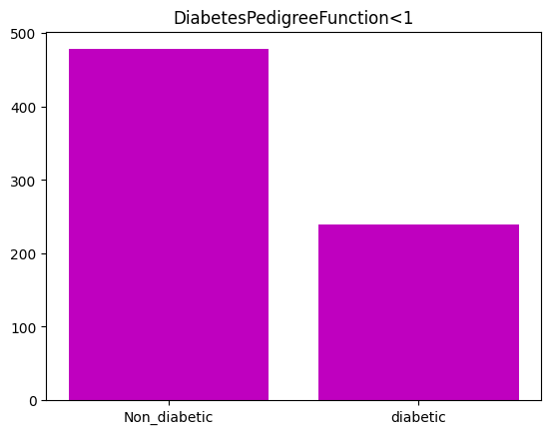
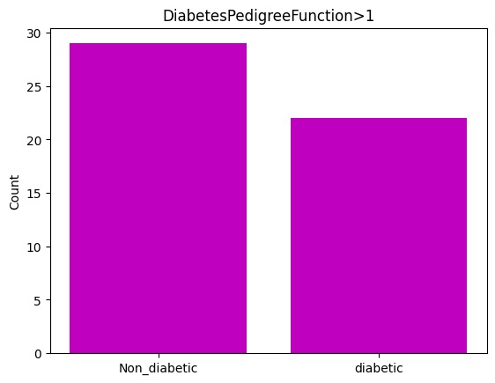
genetic likelihood of developing diabetes

Slide 9
Action taken
Missing values skinthickness ~29% , Insulin ~48% - replace with medians, (Glucose with mean)
Use standardscaler for scaling
Insulin >300 is rare so feature clip it to 300
Split the sample into training and testing set (20%)

Slide 10
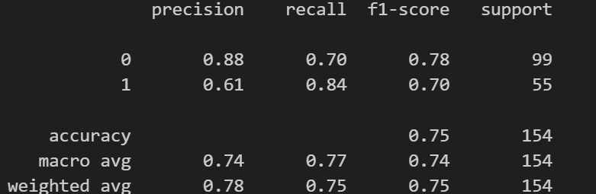
Neural network with one layer

Slide 11
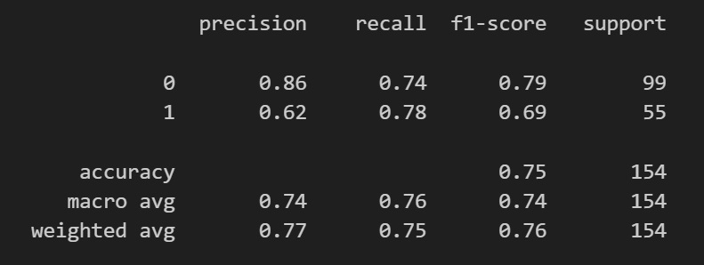
Neural network with two layers

Slide 12
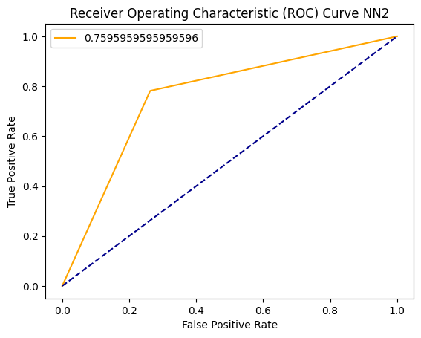
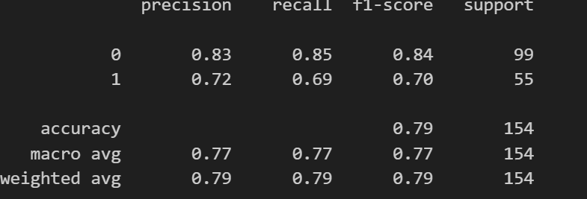
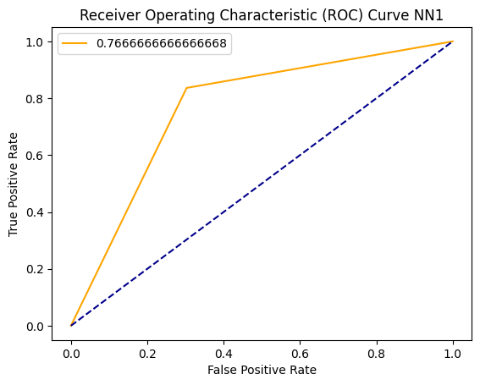
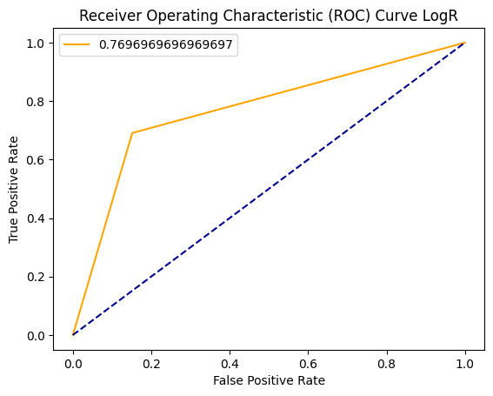
COMPARISION WITH Logistic regression

Slide 13
conclusion
Data set may not be complex enough for Neural network
Neural network more suitable for huge data set
No need for further layers
We can improve the model performance by adding insulin data and adding more diabetic patient’s data to make it balance

